Slide 1
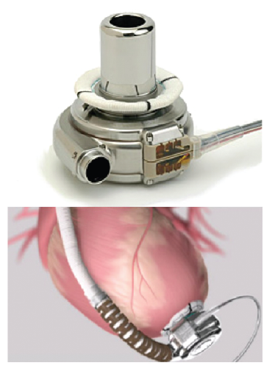
Wiedemann D, Haberl T, Riebandt J, Simon P, Laufer G, Zimpfer D
Figure 4: HeartWare Ventricular Assist Device
Citation: European Cardiology Review 2014;9(1):54–8
https://doi.org/10.15420/ecr.2014.9.1.54

