Slide 1
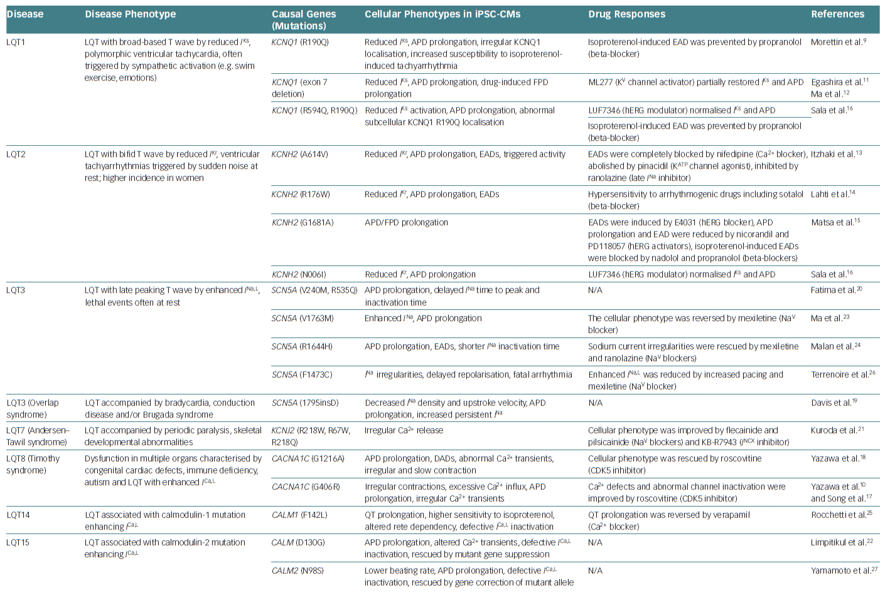
Nakao S, Ihara D, Hasegawa K, Kawamura T
Table 1: Human Induced Pluripotent Stem Cell-Derived Cardiomyocyte Models of Inherited Arrhythmias
Citation: European Cardiology Review 2020;15:e02.
https://doi.org/10.15420/ecr.2019.03

