Slide 1
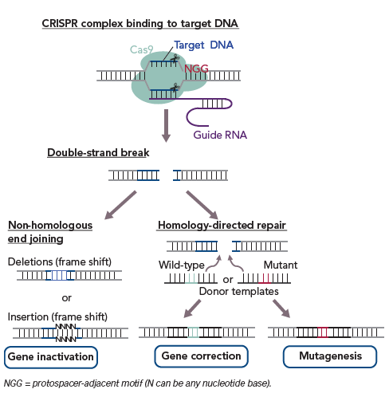
Nakao S, Ihara D, Hasegawa K, Kawamura T
Figure 2: Principle of Clustered Regularly Interspaced Short Palindromic Repeat (CRISPR)/ CRISPR-associated (Cas) 9-Based Gene Editing
Citation: European Cardiology Review 2020;15:e02.
https://doi.org/10.15420/ecr.2019.03

