Slide 1
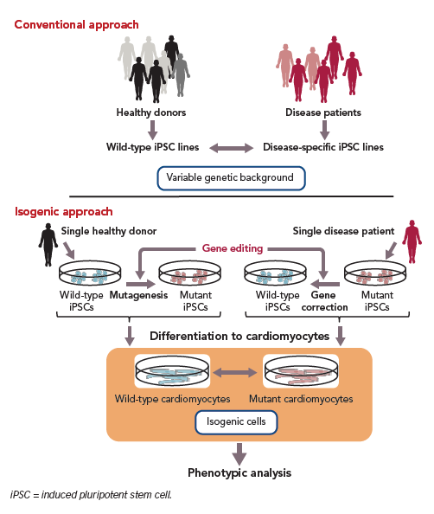
Nakao S, Ihara D, Hasegawa K, Kawamura T
Figure 3: Gene Editing in Human Induced Pluripotent Stem Cell for Cardiac Applications
Citation: European Cardiology Review 2020;15:e02.
https://doi.org/10.15420/ecr.2019.03

