Slide 1
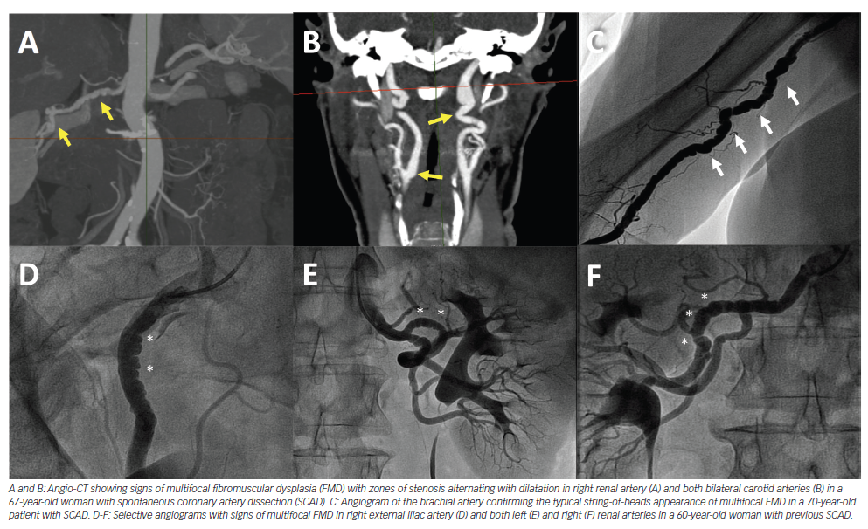
Garcia-Guimarães M, Bastante T, Antuña P, Jimenez C, Cuerda Fdl, Cuesta J, Rivero F, Premawardhana D, Adlam D, Alfonso F
Figure 1: Fibromuscular Dysplasia in Spontaneous Coronary Artery Dissection
Citation: European Cardiology Review 2020;15:e03.
https://doi.org/10.15420/ecr.2019.01

