Slide 1

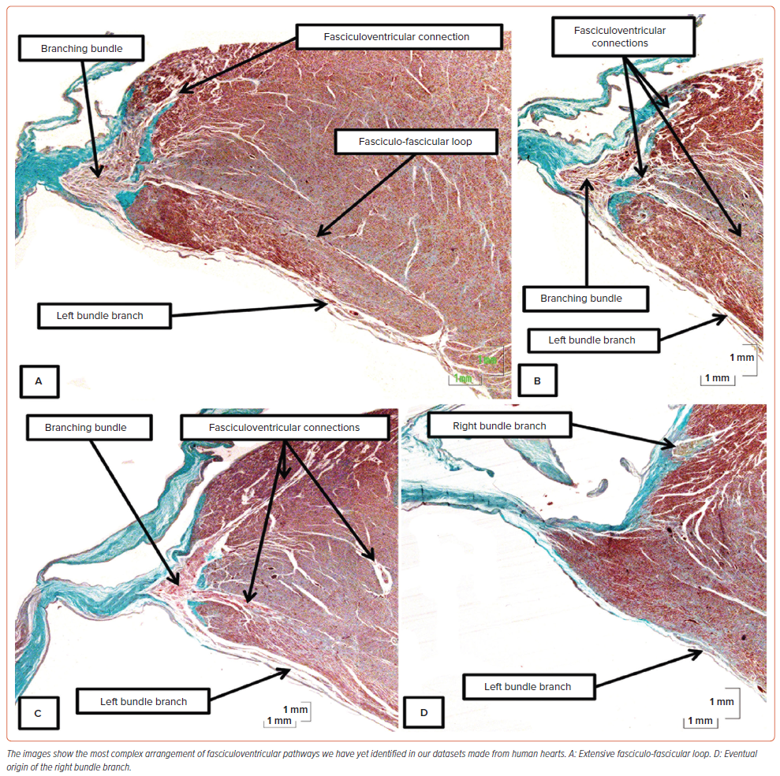
Anderson RH, Sánchez-Quintana D, Spicer DE, Macías Y, Cook A, Cabrera J�, Mahmud R, Back Sternick E, Tretter JT
Figure 5: Histological Arrangement of Fasciculoventricular Pathways
Citation: Arrhythmia & Electrophysiology Review 2024;13:e20.
https://doi.org/10.15420/aer.2024.15

