Slide 1
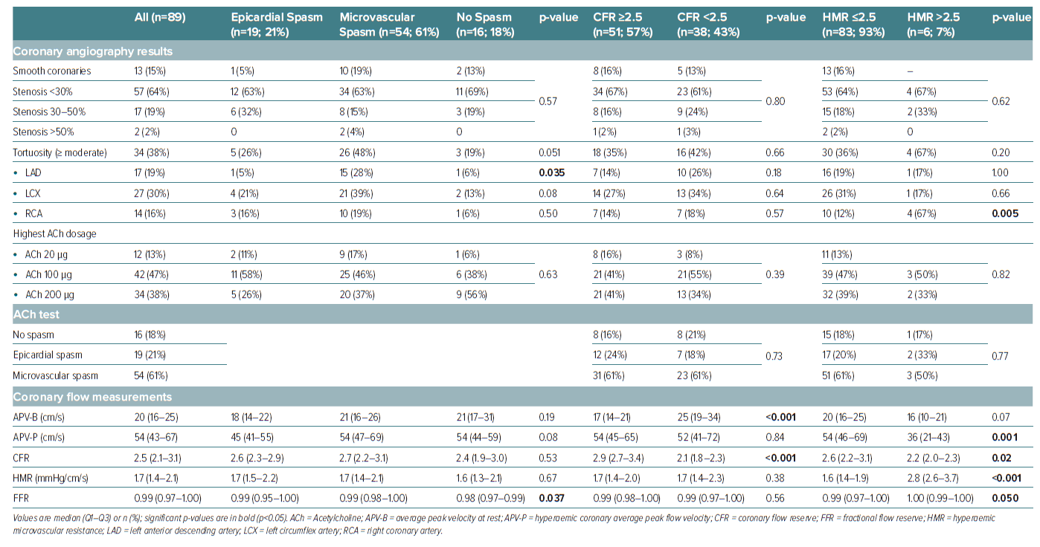
McChord J, Hubert A, Sechtem U, Bekeredjian R, Ong P, Seitz A
Table 2: Coronary Angiography Data
Citation: European Cardiology Review 2024;19:e19.
https://doi.org/10.15420/ecr.2024.32

