Slide 1
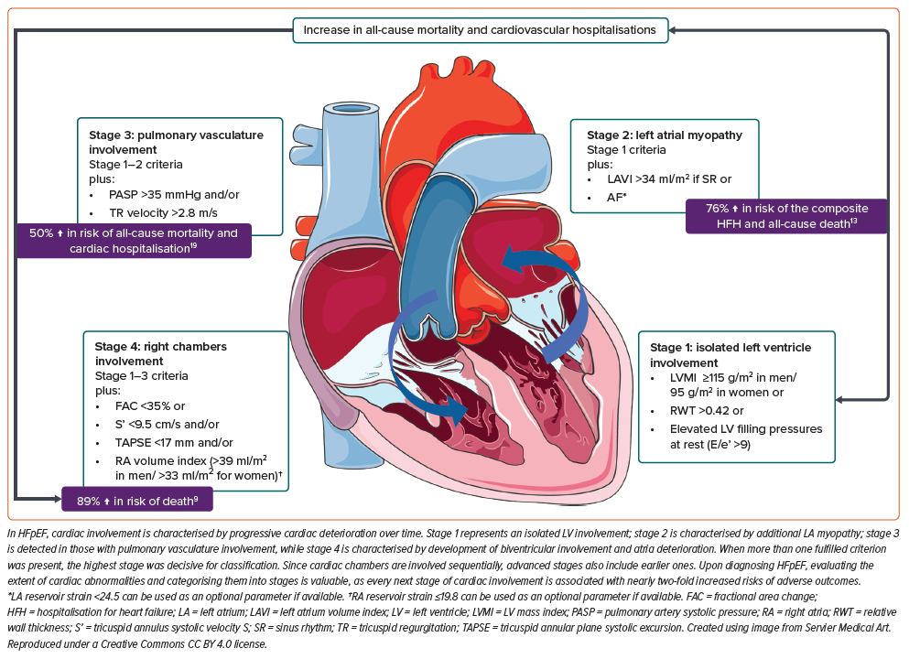
Shchendrygina A, Giverts I, Tokmakova M, Kharchenko E, Vlasova A, Rogova A, Zakharov N, Mukhina N
Figure 1: Staging of Cardiac Abnormalities in Heart Failure with Preserved Ejection Fraction Patients
Citation: European Cardiology Review 2024;19:e20.
https://doi.org/10.15420/ecr.2024.31

