Slide 1
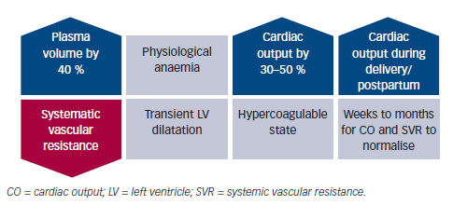
Anthony J, Sliwa K
Figure 1: Summary of Physiological Changes Occurring During Pregnancy
Citation: Cardiac Failure Review 2016;2(1):20–6
https://doi.org/10.15420/cfr.2015:24:2

