Slide 1
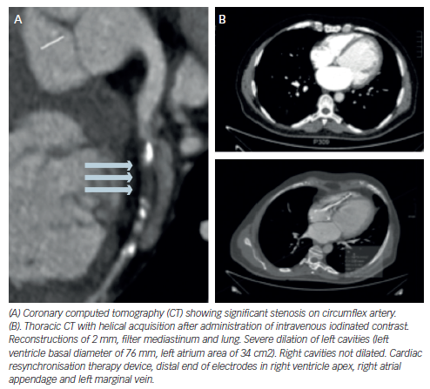
Melero-Ferrer JL, López-Vilella R, Morillas-Climent H, Sanz-Sánchez J, Sánchez-Lázaro IJ, Almenar-Bonet L, Martínez-Dolz L
Figure 5: Contrast-enhanced Multidetector Computed Tomography Image
Citation: Cardiac Failure Review 2016;2(1):27–34
https://doi.org/10.15420/cfr.2015:29:2

