Slide 1
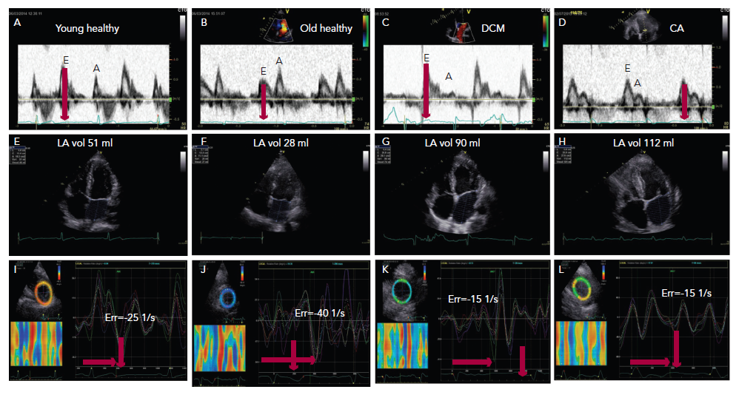
Henein MY, Lindqvist P
Figure 1: Three Diastolic Phases are Shown: Early Diastole, Diastasis and Late Diastole Atrial Systole
Citation: Cardiac Failure Review 2015;1(2):87–9
https://doi.org/10.15420/cfr.2015.1.2.87

