Slide 1
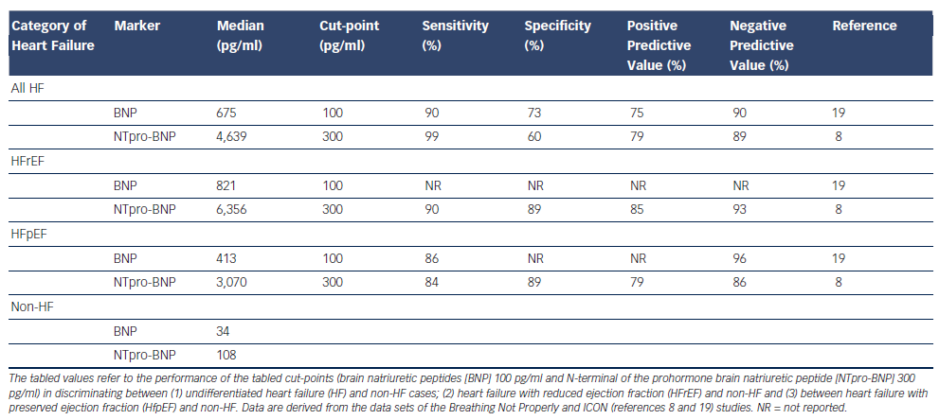
Richards AM
Table 1: Plasma B-type Natriuretic Peptides – Diagnostic Performance in the Emergency Department
Citation: Cardiac Failure Review 2015;1(2):107–11
https://doi.org/10.15420/cfr.2015.1.2.107

