Slide 1
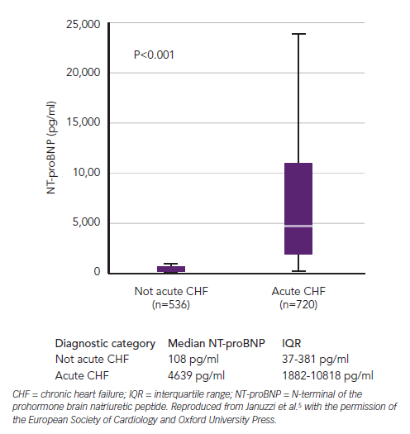
Richards AM
Figure 1: N-terminal of the Prohormone Brain Natriuretic Peptide Values between Diagnostic Groups in the ICON Study
Citation: Cardiac Failure Review 2015;1(2):107–11
https://doi.org/10.15420/cfr.2015.1.2.107

