Slide 1
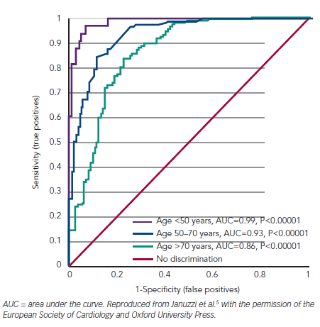
Richards AM
Figure 2: Receiver–Operator Curves for N-terminal of the Prohormone Brain Natriuretic Peptide in Discriminating Acute Heart Failure Among Patients Presenting with Acute Breathlessness by Age
Citation: Cardiac Failure Review 2015;1(2):107–11
https://doi.org/10.15420/cfr.2015.1.2.107

