Slide 1
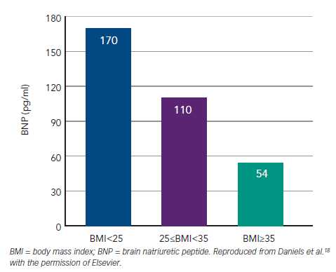
Richards AM
Figure 4: Plasma BNP Concentrations Providing 90 % Sensitivity for Diagnosis of Acute Heart Failure Among Patients with Acute Breathlessness categorised by BMI
Citation: Cardiac Failure Review 2015;1(2):107–11
https://doi.org/10.15420/cfr.2015.1.2.107

