Slide 1
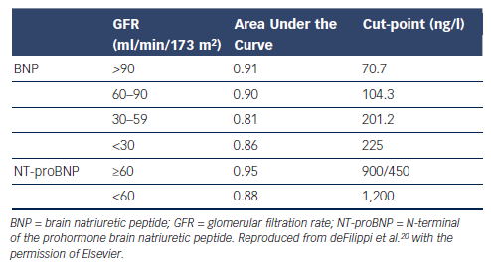
Richards AM
Table 2: Impact of Renal Disease on the Diagnosis of Acute Decompensated Heart Failure in Patients Presenting with Dyspnoea
Citation: Cardiac Failure Review 2015;1(2):107–11
https://doi.org/10.15420/cfr.2015.1.2.107

