Slide 1
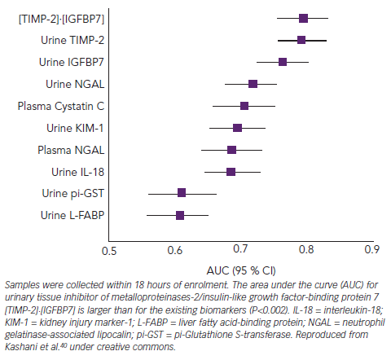
Richards AM
Figure 5: AUC for Known and Novel and Urinary Biomarkers for Acute Kidney Injury in a Heterogeneous Intensive Care Unit Population
Citation: Cardiac Failure Review 2015;1(2):107–11
https://doi.org/10.15420/cfr.2015.1.2.107

