Slide 1
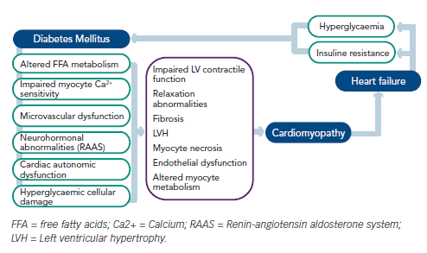
Campbell P, Krim S, Ventura H
Figure 1: The Bi-directional Impact of Diabetes Mellitus and Heart Failure
Citation: Cardiac Failure Review 2015;1(1):8–10
https://doi.org/10.15420/cfr.2015.01.01.8

