Slide 1
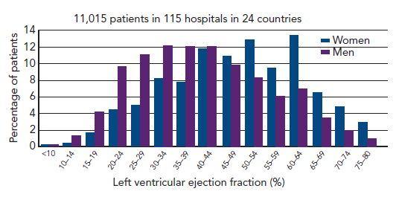
Coats AJ, Shewan LG
Figure 1: Distribution of Left Ventricular Ejection Fractions in Hospital-diagnosed Cases of Heart Failure in Europe
Citation: Cardiac Failure Review 2015;1(1):11–5
https://doi.org/10.15420/CFR.2015.01.01.11

