Slide 1
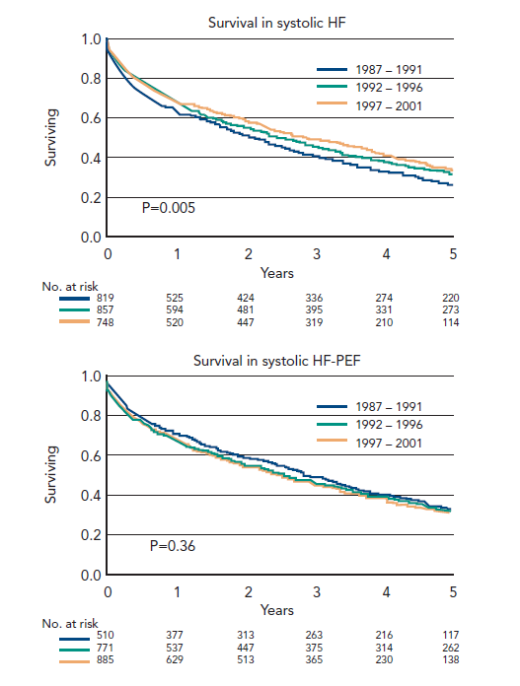
Coats AJ, Shewan LG
Figure 2: Changes In Survival Over Time For (A) Heart Failure With (A) Reduced And (B) Preserved Ejection Fraction
Citation: Cardiac Failure Review 2015;1(1):11–5
https://doi.org/10.15420/CFR.2015.01.01.11

