Slide 1
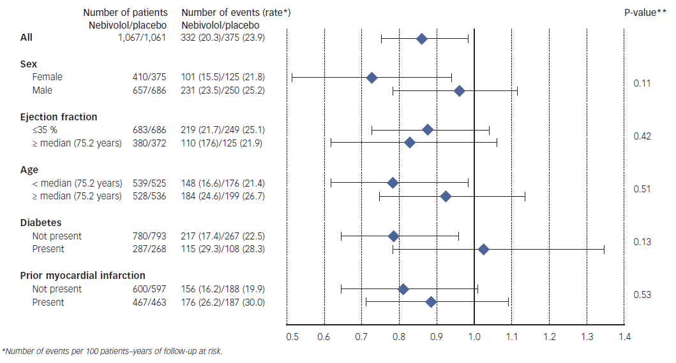
Coats AJ, Shewan LG
Figure 3: Subgroup Analysis of the Primary Endpoint of the SENIORS Trial Showing Similar Effects in HF-PEF as in Heart Failure with Preserved Ejection Fraction Patients
Citation: Cardiac Failure Review 2015;1(1):11–5
https://doi.org/10.15420/CFR.2015.01.01.11

