Slide 1
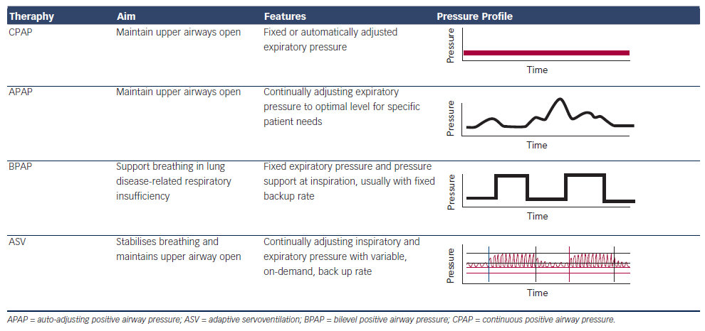
Cowie MR, Woehrle H, Oldenburg O, Damy T, van der Meer P, Erdmann E, Metra M, Zannad F, Trochu JN, Gullestad L, Fu M, Böhm M, Auricchio A, Levy P
Table 1: Features of Different Types of Positive Airway Pressure Therapy
Citation: Cardiac Failure Review 2015;1(1):16–24
https://doi.org/10.15420/CFR.2015.01.01.16

