Slide 1
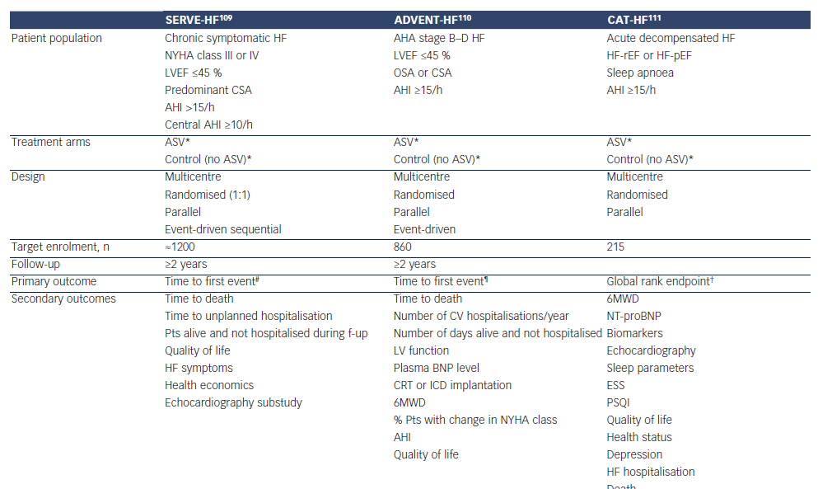
Cowie MR, Woehrle H, Oldenburg O, Damy T, van der Meer P, Erdmann E, Metra M, Zannad F, Trochu JN, Gullestad L, Fu M, Böhm M, Auricchio A, Levy P
Table 3: Summary of Ongoing Mortality Studies Investigating Adaptive Servoventilation in Patients with Heart Failure and Central Sleep Apnoea
Citation: Cardiac Failure Review 2015;1(1):16–24
https://doi.org/10.15420/CFR.2015.01.01.16

