Slide 1
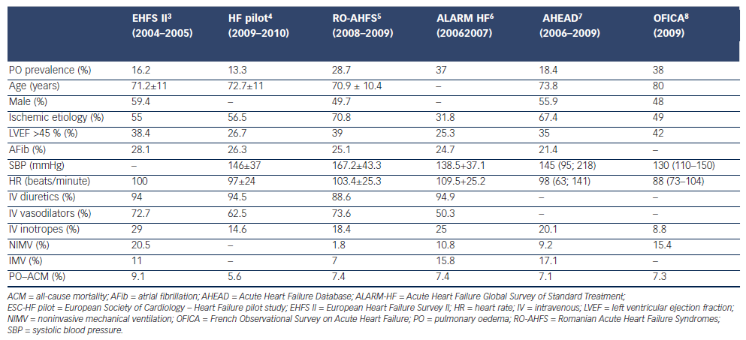
Chioncel O, Collins SP, Ambrosy AP, Gheorghiade M, Filippatos G
Table 1: Prevalence, Demography, Clinical Presentation, In-Hospital Management, and In-Hospital Mortality Rate of Patients Admitted with Pulmonary Oedema in Recent European Heart Failure Registries
Citation: Cardiac Failure Review 2015;1(1):38-45
https://doi.org/10.15420/CFR.2015.01.01.38

