Slide 1
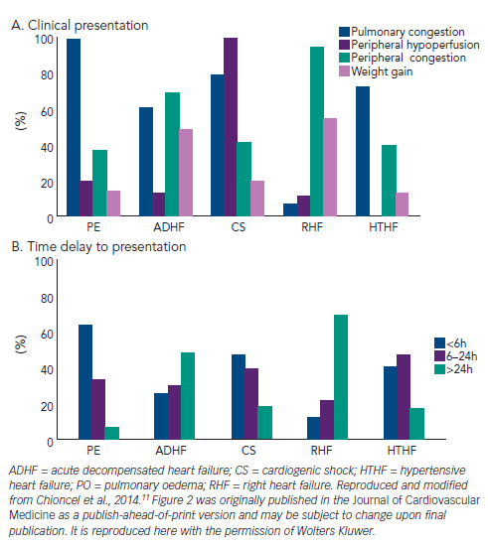
Chioncel O, Collins SP, Ambrosy AP, Gheorghiade M, Filippatos G
Figure 2: A. Clinical Signs at Initial Clinical Presentation; B. Time Delay to Presentation in Terms of Symptom Onset
Citation: Cardiac Failure Review 2015;1(1):38-45
https://doi.org/10.15420/CFR.2015.01.01.38

