Slide 1
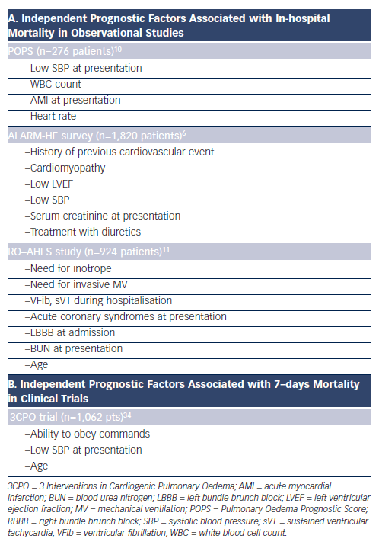
Chioncel O, Collins SP, Ambrosy AP, Gheorghiade M, Filippatos G
Table 2: Prognostic Variables for All-cause Mortality in Pulmonary Oedema Patients
Citation: Cardiac Failure Review 2015;1(1):38-45
https://doi.org/10.15420/CFR.2015.01.01.38

