Slide 1
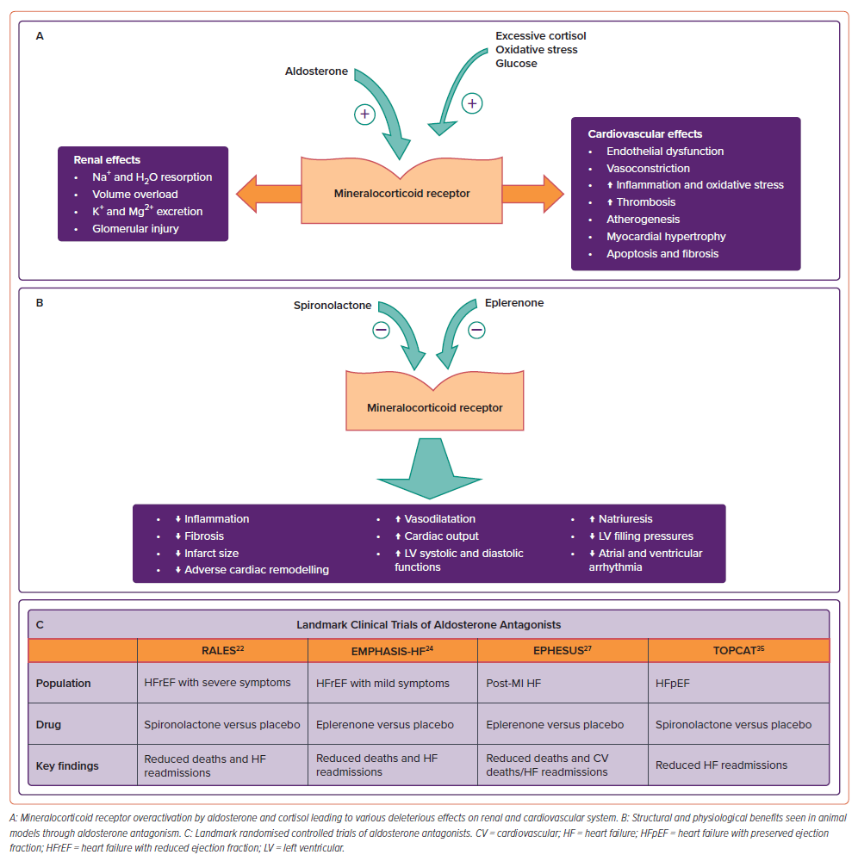
Sethi R, Vishwakarma P, Pradhan A
Figure 1: Mineralocorticoid Receptor Inhibition
Citation: Cardiac Failure Review 2024;10:e15.
https://doi.org/10.15420/cfr.2024.10

