Slide 1
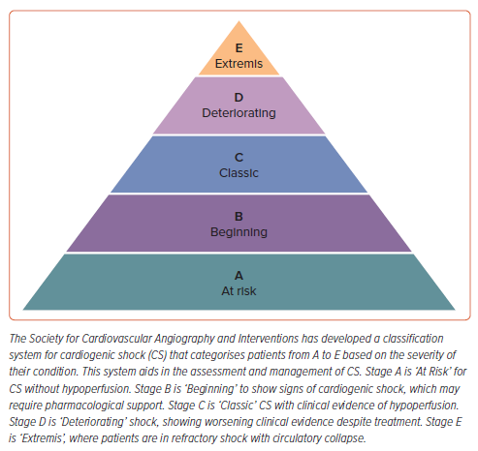
Susilo H, Aldian FM, Wungu CDK, Alsagaff MY, Sutanto H, Multazam CECZ
Figure 1: Society for Cardiovascular Angiography and Interventions Shock Classification Pyramid
Citation: European Cardiology Review 2024;19:e21.
https://doi.org/10.15420/ecr.2024.16

