Slide 1
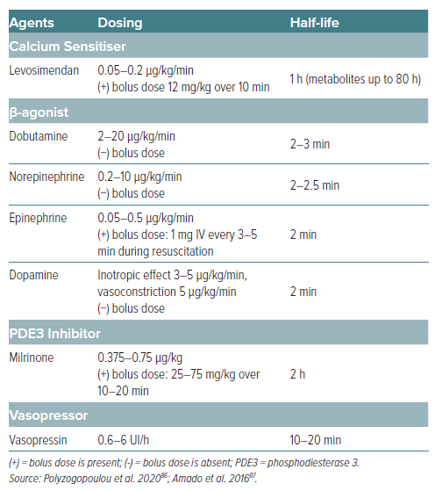
Susilo H, Aldian FM, Wungu CDK, Alsagaff MY, Sutanto H, Multazam CECZ
Table 4: Dosing of Several Inotropes and Vasopressors
Citation: European Cardiology Review 2024;19:e21.
https://doi.org/10.15420/ecr.2024.16

