Slide 1
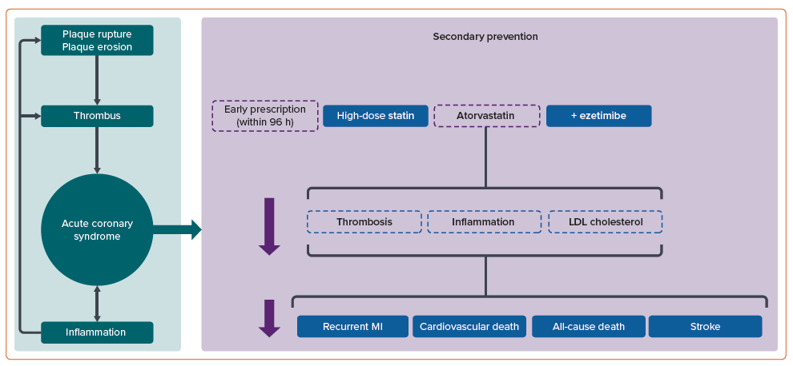
Sallam M, Hassan H, Connolly D, Rahman MS
Figure 1: Benefits of Early Prescription of Atorvastatin and Ezetimibe in Patients with Acute Coronary Syndrome
Citation: European Cardiology Review 2024;19:e22.
https://doi.org/10.15420/ecr.2024.06

