Slide 1
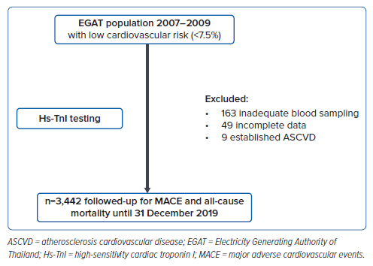
Sabkaewyod P, Vathesatogkit P, Sritara P
Figure 1: Study Flow
Citation: Journal of Asian Pacific Society of Cardiology 2024;3:e42.
https://doi.org/10.15420/japsc.2023.34

