Slide 1
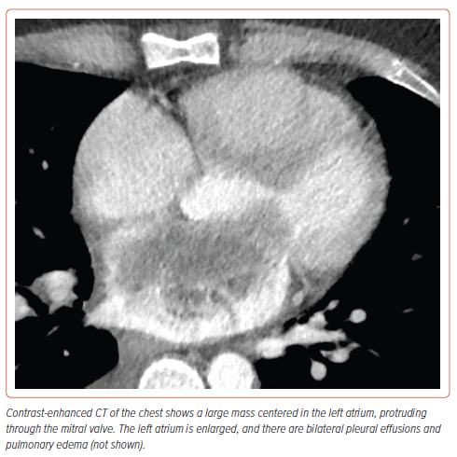
Shaikh P, Rivera MR, Beal MA, Schill MR, Pawale A, Moreno JD
Figure 1: Initial CT Imaging of the Mass
Citation: US Cardiology Review 2024;18:e19.
https://doi.org/10.15420/usc.2024.02

