Slide 1
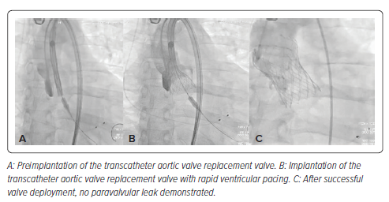
Mutlu D, Inanc IH, Mutlu OPZ, Marmagkiolis K, Iliescu CA, Cilingiroglu M
Figure 2: Intraoperative Fluoroscopic Images
Citation: US Cardiology Review 2024;18:e20.
https://doi.org/10.15420/usc.2024.19

