Slide 1
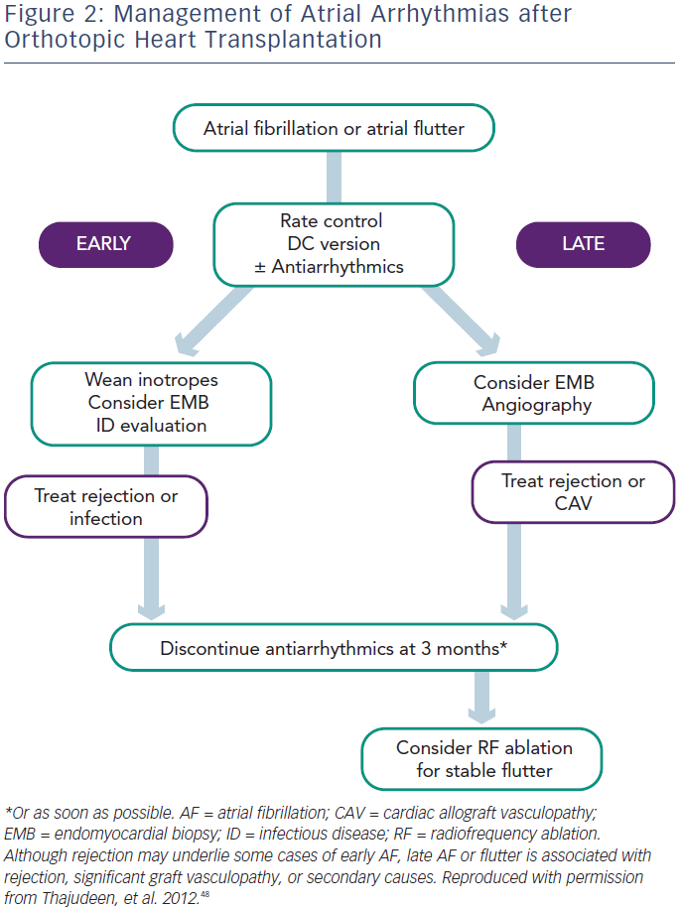
Hamon D, Taleski J, Vaseghi M, Shivkumar K, Boyle NG
Management of Atrial Arrhythmias after Orthotopic Heart Transplantation
Citation: Arrhythmia & Electrophysiology Review 2014;3(3):149–55
https://doi.org/10.15420/aer.2014.3.3.149

