Slide 1
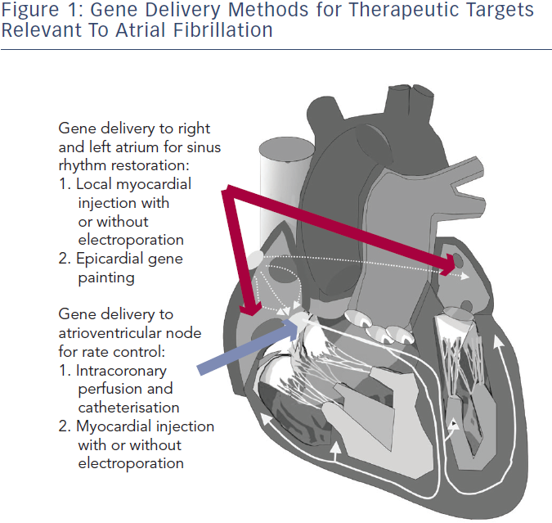
Liu Z, Donahue JK
Gene Therapy Targets and Strategies for Ablation of Atrial Fibrillation
Citation: Arrhythmia & Electrophysiology Review 2014;3(3):139–44
https://doi.org/10.15420/aer.2014.3.3.139

