Slide 1
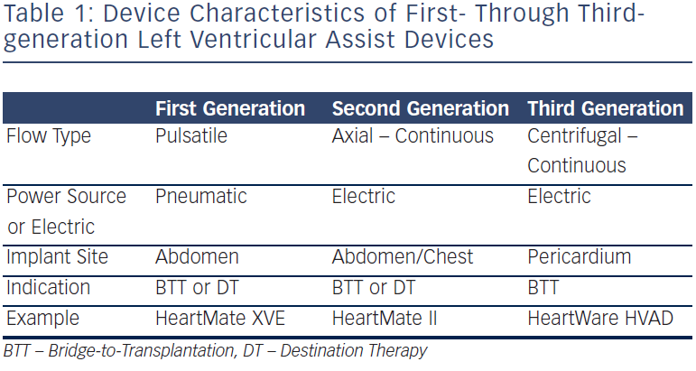
Griffin JM, Katz JN
Device Characteristics of First- Through Thirdgeneration Left Ventricular Assist Devices
Citation: Arrhythmia & Electrophysiology Review 2014;3(3):145–8
https://doi.org/10.15420/aer.2014.3.3.145

