Slide 1
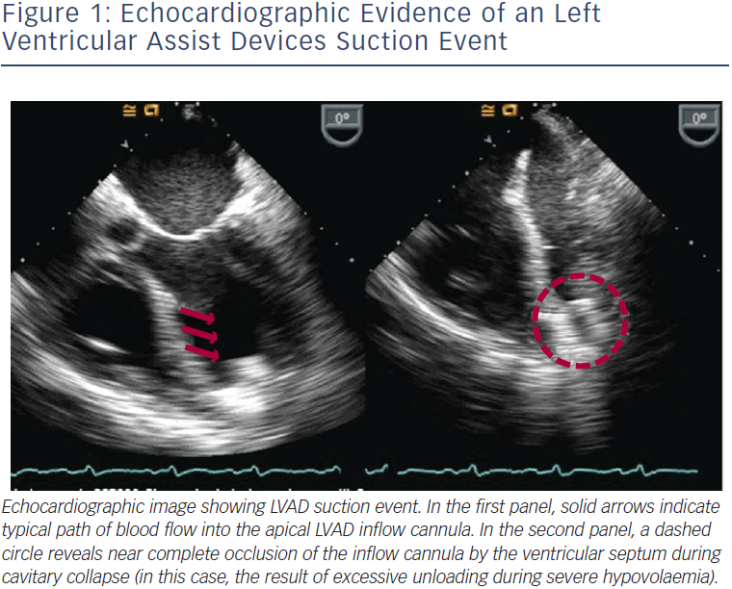
Griffin JM, Katz JN
Echocardiographic Evidence of an Left Ventricular Assist Devices Suction Event
Citation: Arrhythmia & Electrophysiology Review 2014;3(3):145–8
https://doi.org/10.15420/aer.2014.3.3.145

