Slide 1
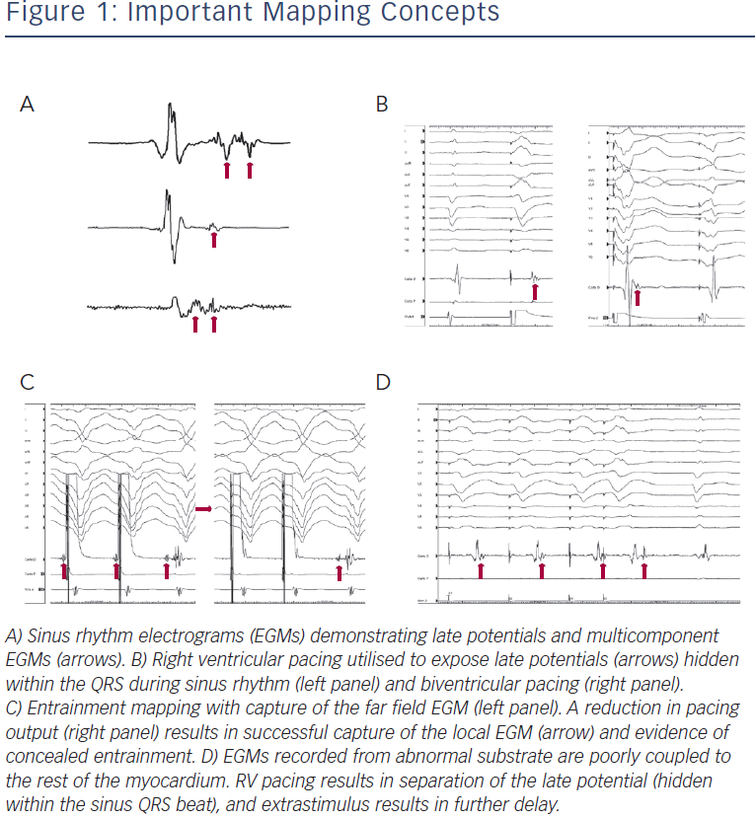
Sadek MM, Schaller RD, Supple GE, Frankel DS, Riley MP, Hutchinson MD, Garcia FC, Lin D, Dixit S, Zado ES, Callans DJ, Marchlinski FE
Arrhythmias in Transplanted Hearts and Main Underlying Mechanisms
Citation: Arrhythmia & Electrophysiology Review 2014;3(3):161–7
https://doi.org/10.15420/aer.2014.3.3.161

