Slide 1
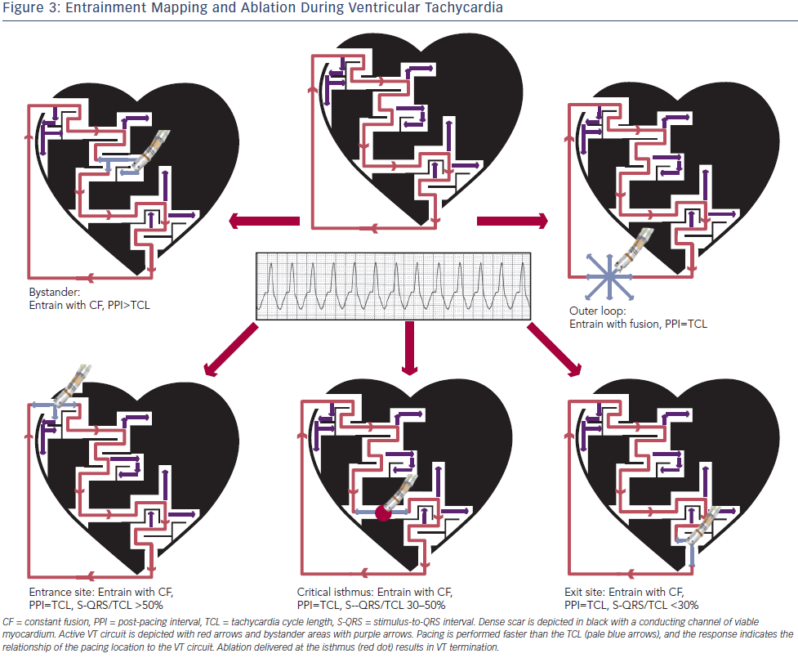
Sadek MM, Schaller RD, Supple GE, Frankel DS, Riley MP, Hutchinson MD, Garcia FC, Lin D, Dixit S, Zado ES, Callans DJ, Marchlinski FE
Entrainment Mapping and Ablation During Ventricular Tachycardia
Citation: Arrhythmia & Electrophysiology Review 2014;3(3):161–7
https://doi.org/10.15420/aer.2014.3.3.161

