Slide 1
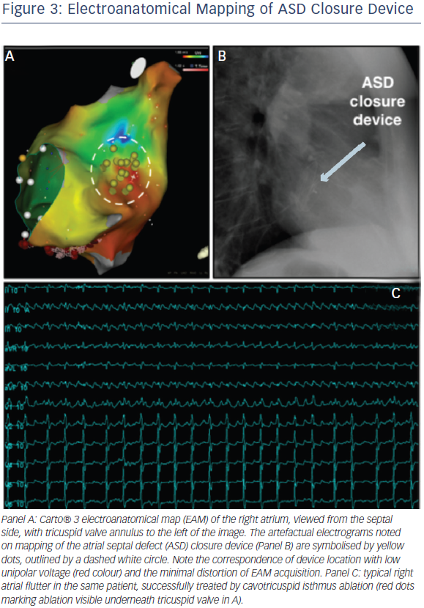
Chubb H, Whitaker J, Williams SE, Head CE, Chung NA, Wright M, O’Neill M
Electroanatomical Mapping of ASD Closure Device
Citation: Arrhythmia & Electrophysiology Review 2014;3(3):168–72
https://doi.org/10.15420/aer.2014.3.3.168

