Slide 1
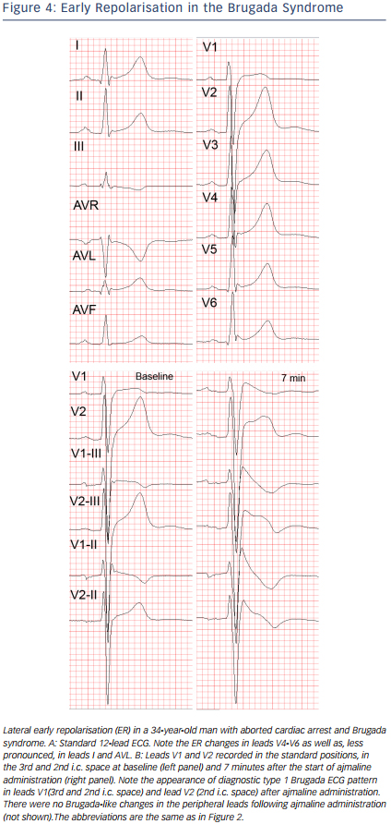
Batchvarov VN
Figure 4: Early Repolarisation in the Brugada Syndrome
Citation: European Cardiology Review 2014;9(2):82–7
https://doi.org/10.15420/ecr.2014.9.2.82

