Slide 1
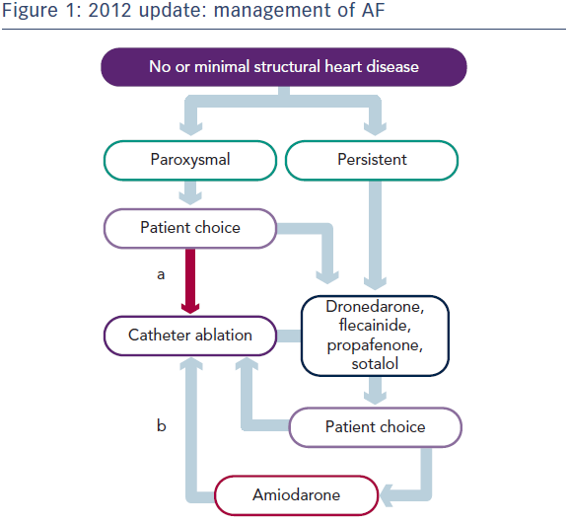
Mountfort K, Kuck KH, Schilling R
Figure 1: 2012 update: management of AF
Citation: European Cardiology Review 2014;9(2):120–2
https://doi.org/10.15420/ecr.2014.9.2.120

