Slide 1
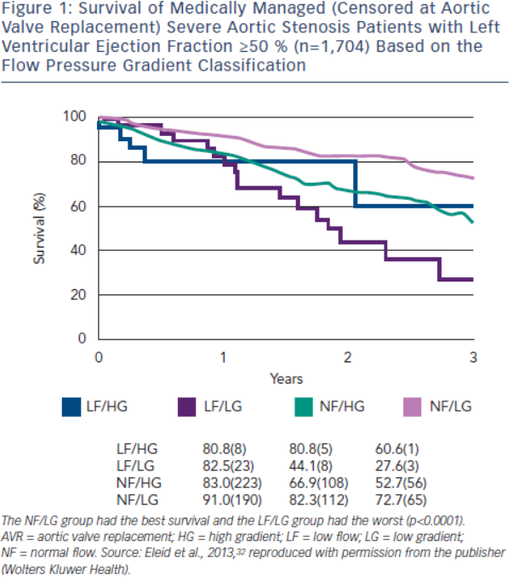
Burwash IG
Figure 1: Survival of Medically Managed (Censored at Aortic Valve Replacement) Severe Aortic Stenosis Patients with Left Ventricular Ejection Fraction ≥50 % (n=1,704) Based on the Flow Pressure Gradient Classification
Citation: European Cardiology Review 2014;9(2):92–9
https://doi.org/10.15420/ecr.2014.9.2.92

