Slide 1
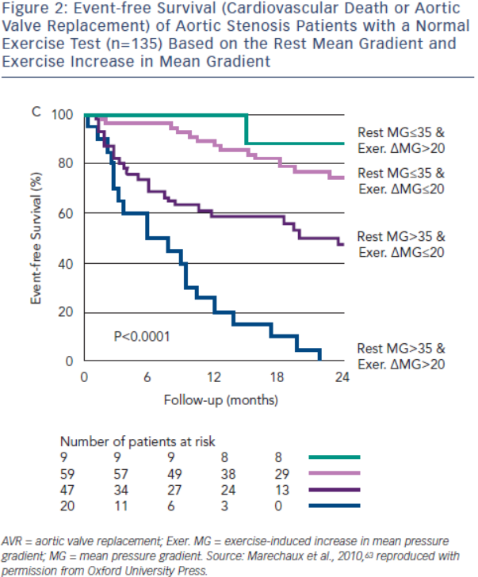
Burwash IG
Figure 2: Event-free Survival (CardioV&lt;sub&gt;AS&lt;/sub&gt;cular Death or Aortic Valve Replacement) of Aortic Stenosis Patients with a Normal Exercise Test (n=135) Based on the Rest Mean Gradient and Exercise Increase in Mean Gradient
Citation: European Cardiology Review 2014;9(2):92–9
https://doi.org/10.15420/ecr.2014.9.2.92

