Slide 1
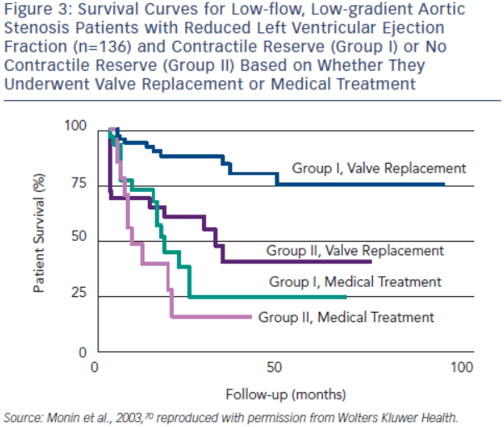
Burwash IG
Figure 3: Survival Curves for Low-flow, Low-gradient Aortic Stenosis Patients with Reduced Left Ventricular Ejection Fraction (n=136) and Contractile Reserve (Group I) or No Contractile Reserve (Group II) Based on Whether They Underwent Valve Replacement or Medical Treatment
Citation: European Cardiology Review 2014;9(2):92–9
https://doi.org/10.15420/ecr.2014.9.2.92

