Slide 1
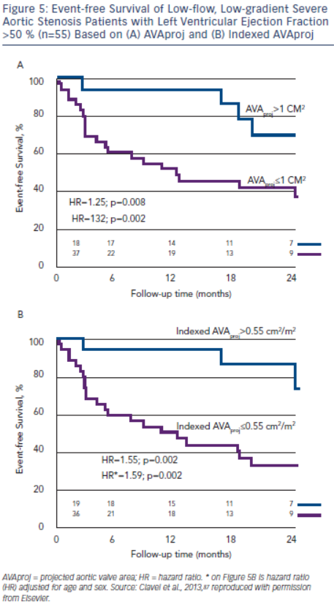
Burwash IG
Figure 5: Event-free Survival of Low-flow, Low-gradient Severe Aortic Stenosis Patients with Left Ventricular Ejection Fraction &gt;50 % (n=55) Based on (A) AVAproj and (B) Indexed AVAproj
Citation: European Cardiology Review 2014;9(2):92–9
https://doi.org/10.15420/ecr.2014.9.2.92

