Slide 1
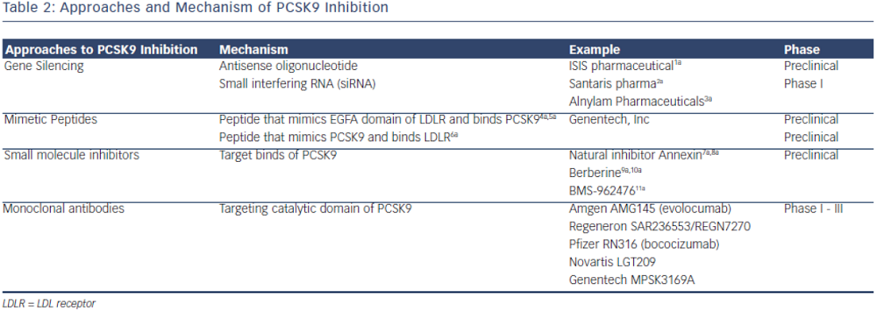
Pitts RN, Eckel R
Table 2: Approaches and Mechanism of PCSK9 Inhibition
Citation: European Cardiology Review 2014;9(2):65–70
https://doi.org/10.15420/ecr.2014.9.2.65

