Slide 1
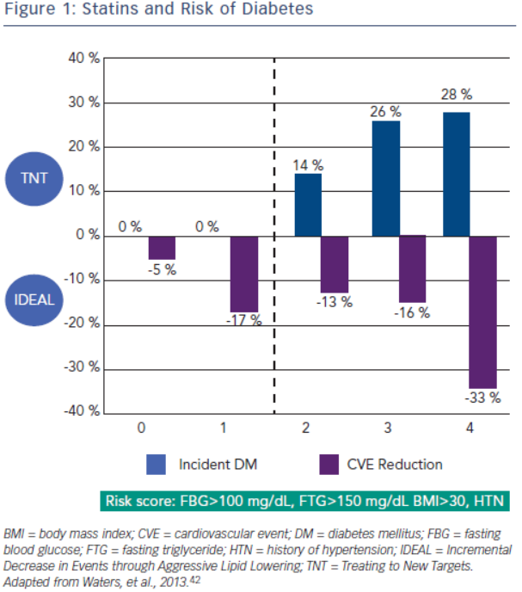
Abdullah K, Rohatgi A
Figure 1: Statins and Risk of Diabetes
Citation: European Cardiology Review 2014;9(2):71–5
https://doi.org/10.15420/ecr.2014.9.2.71

