Slide 1
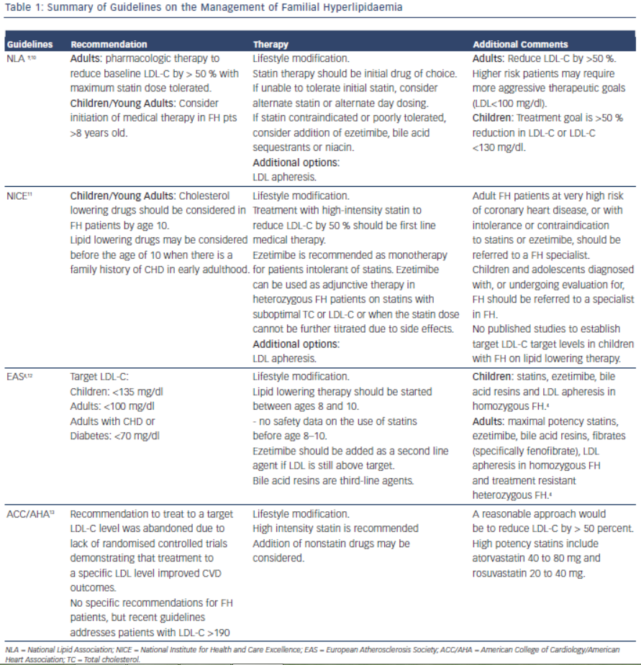
Lambert CT, Sandesara P, Isiadinso I, Gongora MC, Eapen D, Bhatia N, Baer JT, Sperling LS
Table 1: Summary of Guidelines on the Management of Familial Hyperlipidaemia
Citation: European Cardiology Review 2014;9(2):76–81
https://doi.org/10.15420/ecr.2014.9.2.76

