Slide 1
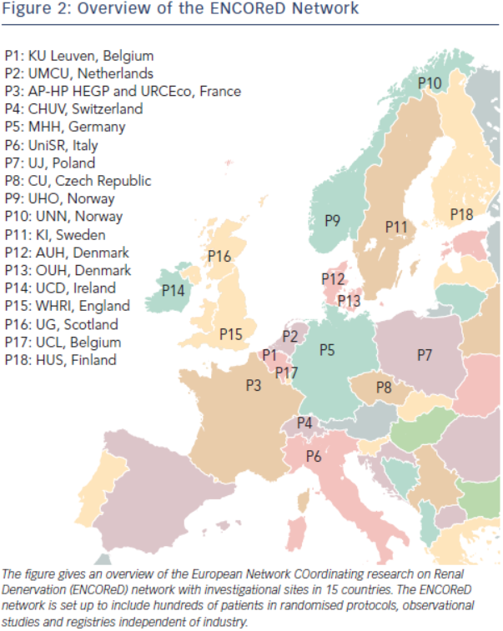
Persu A, Fadl Elmula FEM, Jin Y, Os I, Kjeldsen SE, Staessen JA
Figure 2: Overview of the ENCOReD Network
Citation: European Cardiology Review 2014;9(2):110–4
https://doi.org/10.15420/ecr.2014.9.2.110

